Slide 1
VIDHYADEEP INSTITUE OF MANAGEMENT & TECHNOLOGY, KIM. ELECTRICAL DEPARTMENT
Single Phase
Domestic Wiring
Guided by
mr. vicky paperwala

Slide 2
PREPARED BY:-
STUDENT NAME | ENROLLNMENT NO.
Patel Fenil P. | 130940109073
Patel Mohit D. | 130940109082
Patel Akshay P. | 130940109062
Patel Jwalin M. | 130940109074
Morkar Nirav M. | 130940109051
Patel Milan J. | 130940109081
Patel Dishant R. | 130940109070
Patel Sagar P. | 130940109088
Patel Ashish P. | 130940109064
Patel Ankur S. | 130940109063
Variya Sagar S. | 130940109124
Thakkar Jigar R. | 130940109118
GUIDED BY:- Prof. Vicky Paperwala

Slide 3
INTRODUCTION
Two types of Domestic Wiring :-
1. Single Phase Domestic Wiring
2. Three Phase Domestic Wiring
Single Phase Domestic Wiring :-
230 V.
Two wire method :- One is Phase & Second one is Neutral.
Three Phase Domestic Wiring :-
415 V.
Four Wire Method :- Three are Phase & One is Neutral.

Slide 4
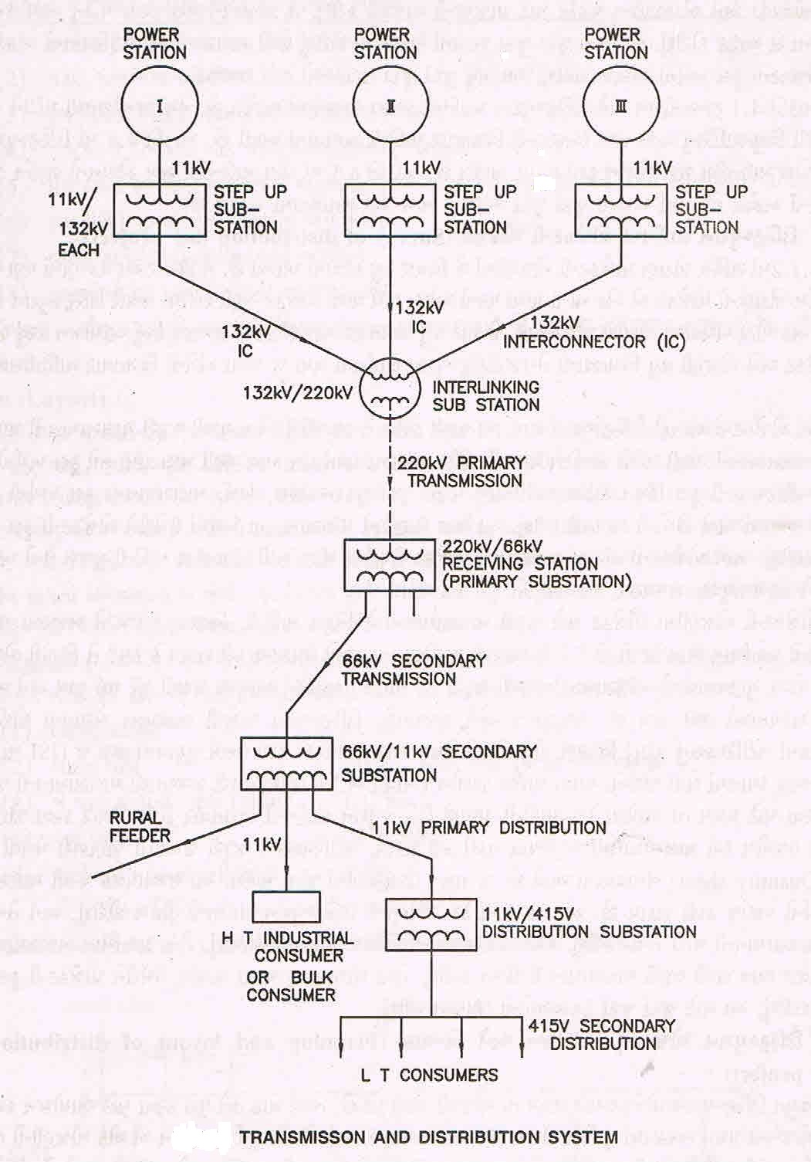
POWER TRANSMISSION AND DISTRIBUTION SYSTEM

Slide 5
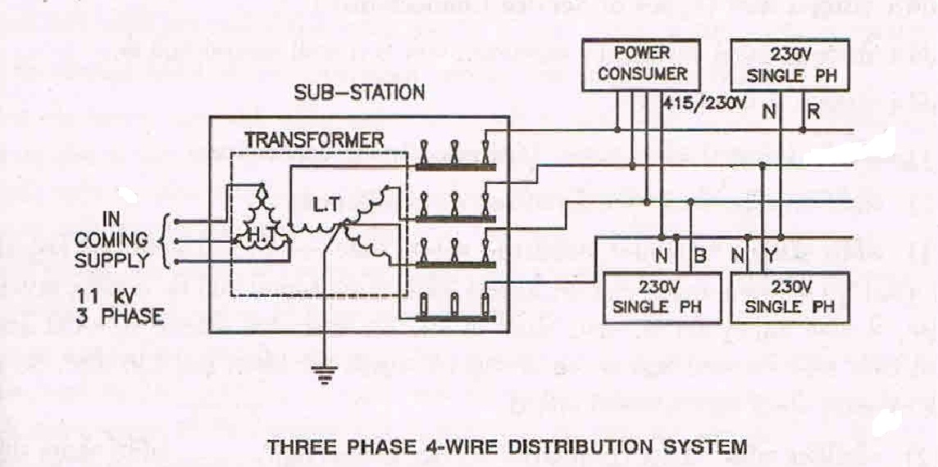
THREE PHASE 4-WIRE DISTRIBUTION SYSTEM

Slide 6
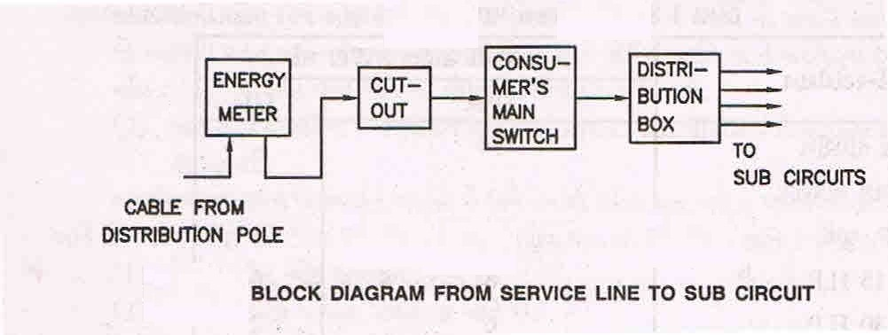
BLOCK DIAGRAM FROM SERVICE LINE TO SUB CIRCUIT

Slide 7
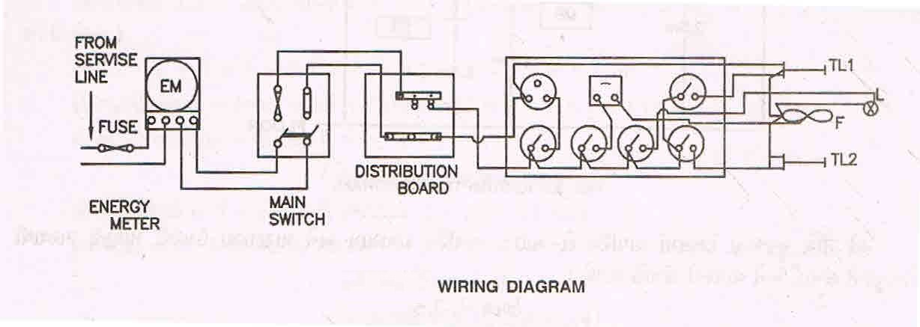
WIRING DIAGRAM

Slide 8
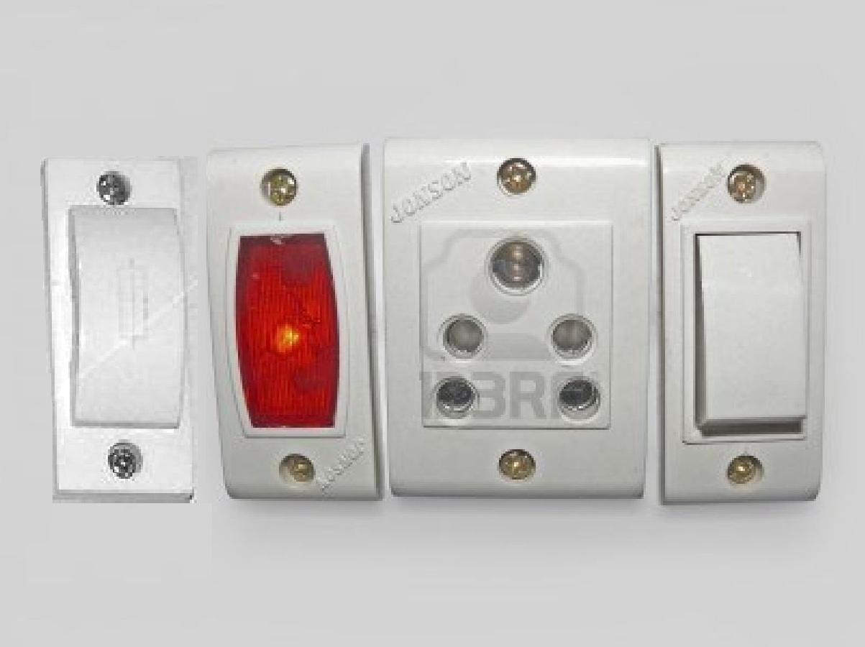
POWER BOARD WIRING CONNECTION DIAGRAM

Slide 9
VARIOUS LIGHTING CIRCUITS

Slide 10
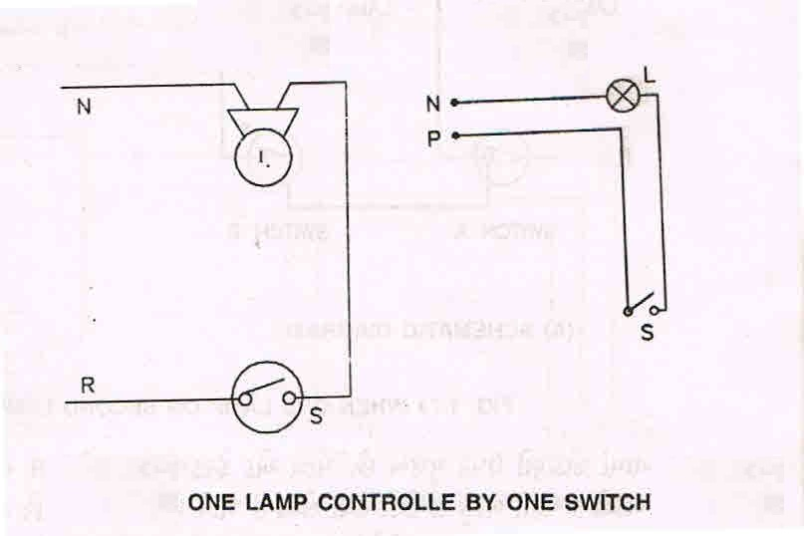
ONE LAMP CONTROLLED BY ONE SWITCH

Slide 11
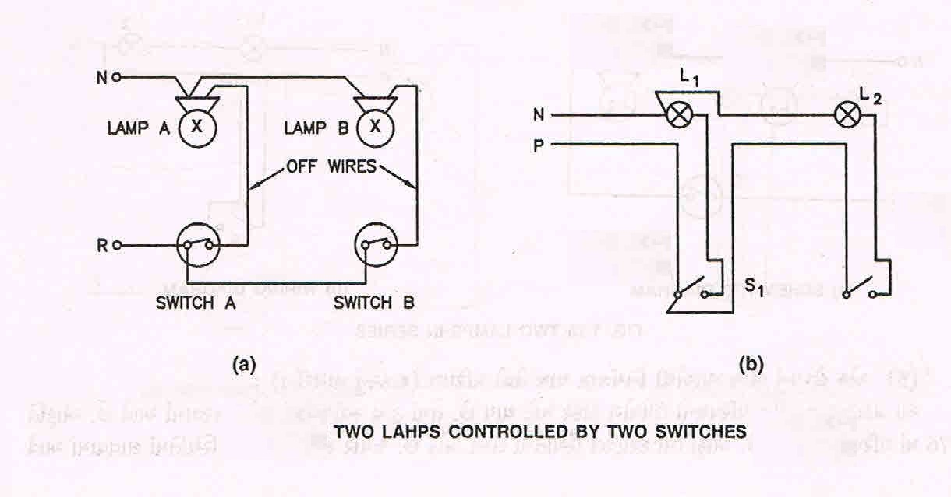
TWO LAMPS CONTROLLED BY TWO SWITCHES

Slide 12
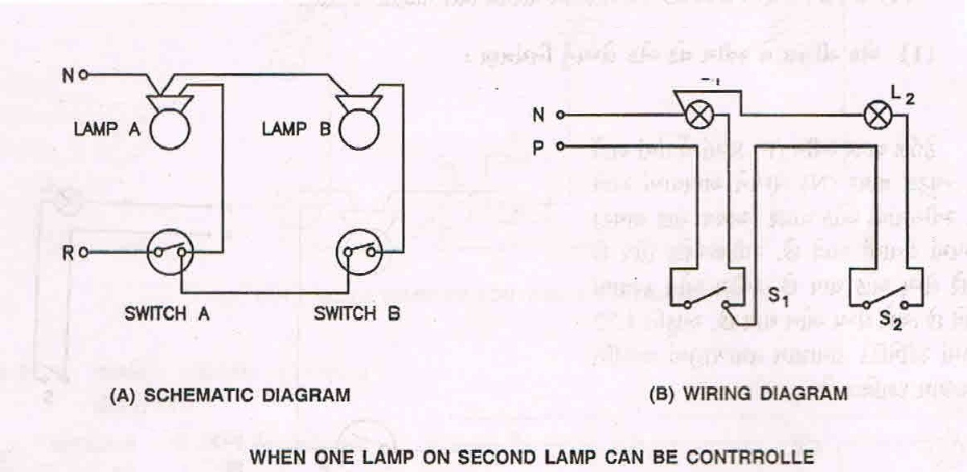
WHEN ONE LAMP ON SECOND LAMP CAN BE CONTROLLED

Slide 13
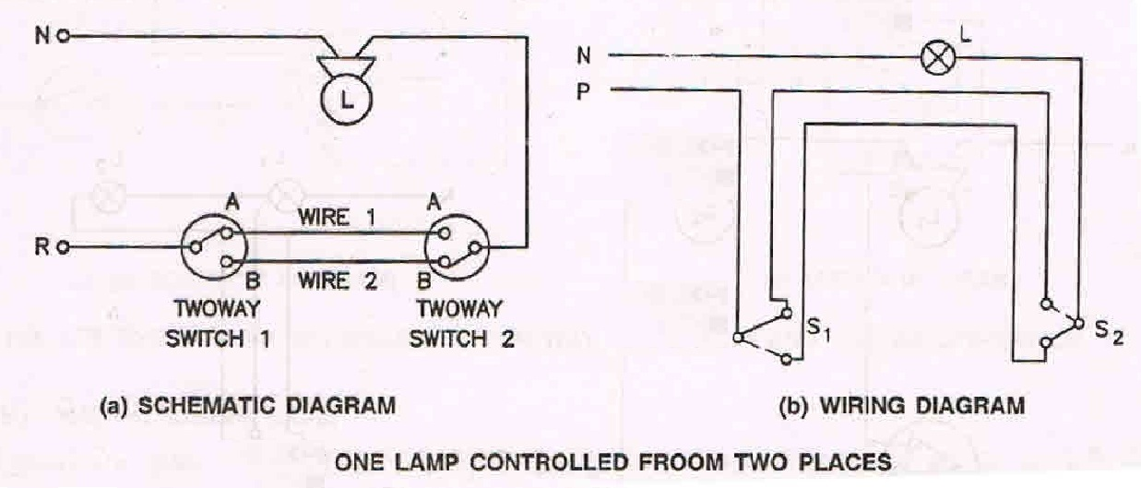
ONE LAMP CONTROLLED FROM TWO PLACES

Slide 14
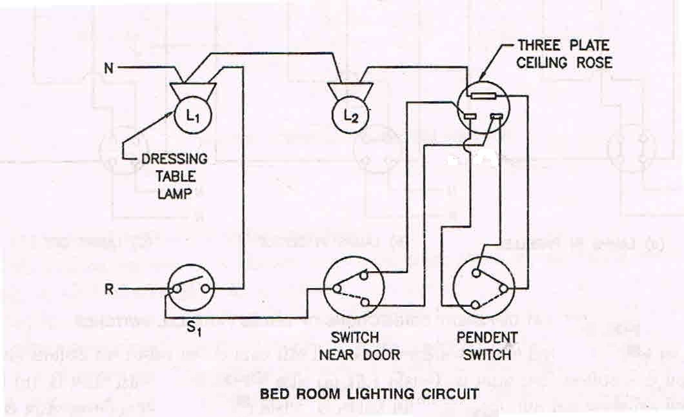
BED ROOM LIDHTING CIRCUIT

Slide 15
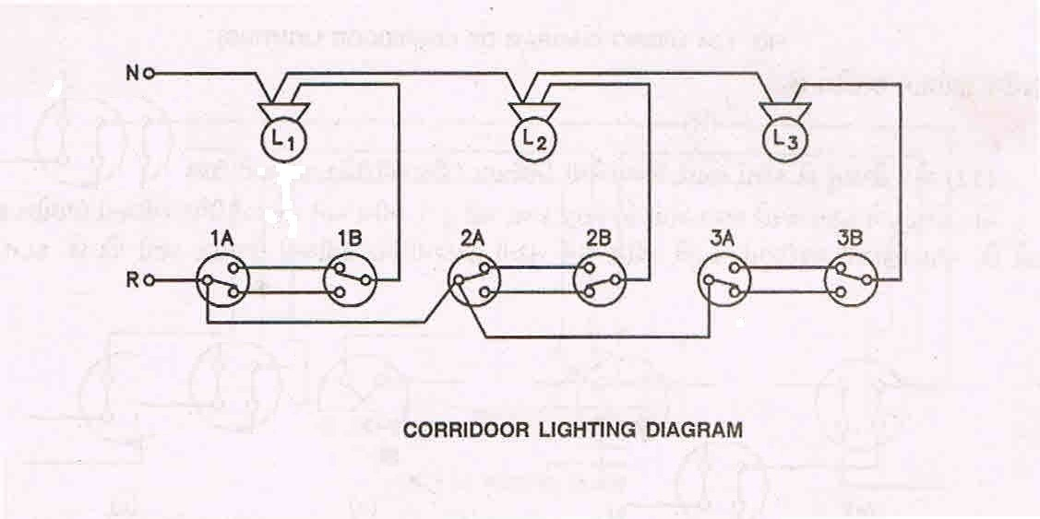
CORRIDOOR LIGHTING DIAGRAM

Slide 16
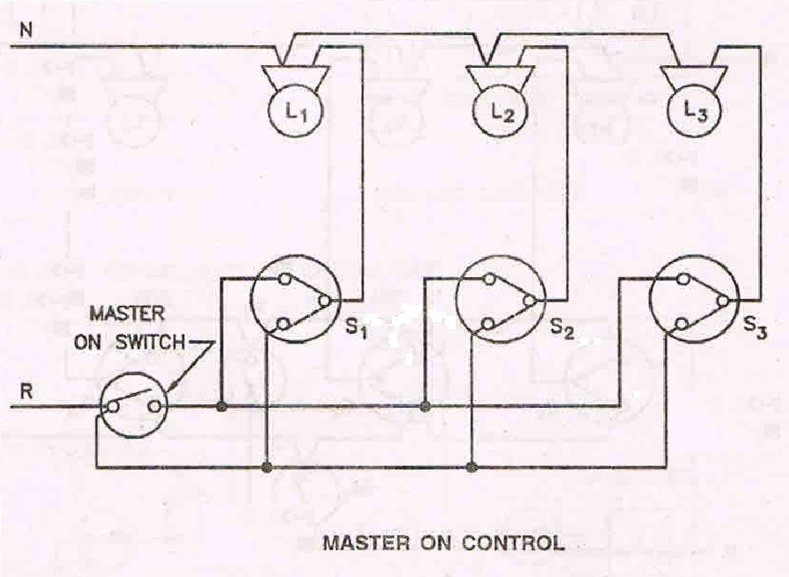
MASTER ON CONTROL

Slide 17
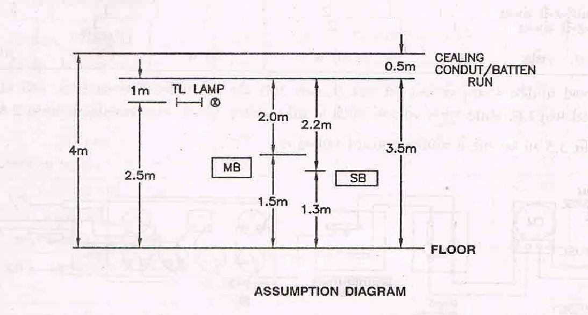
ASSUMPTION DIAGRAM

Slide 18
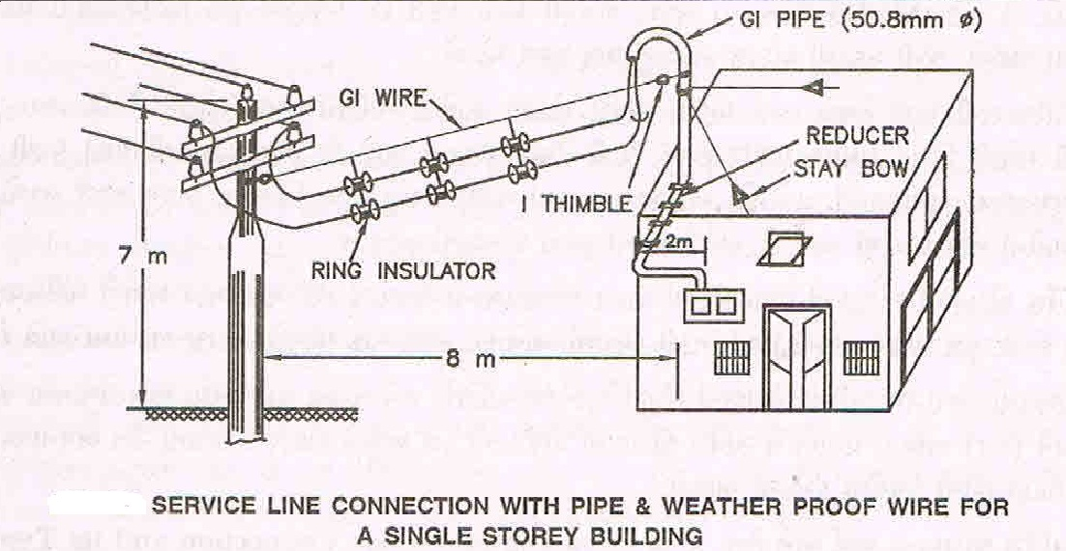
OVERHEAD SERVICE LINE CONNECTION

Slide 19
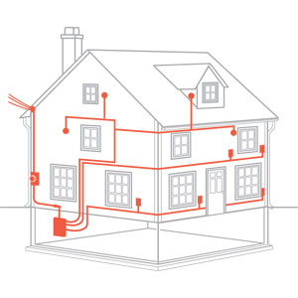
WIRING DIAGRAM OF HOUSE

Slide 20
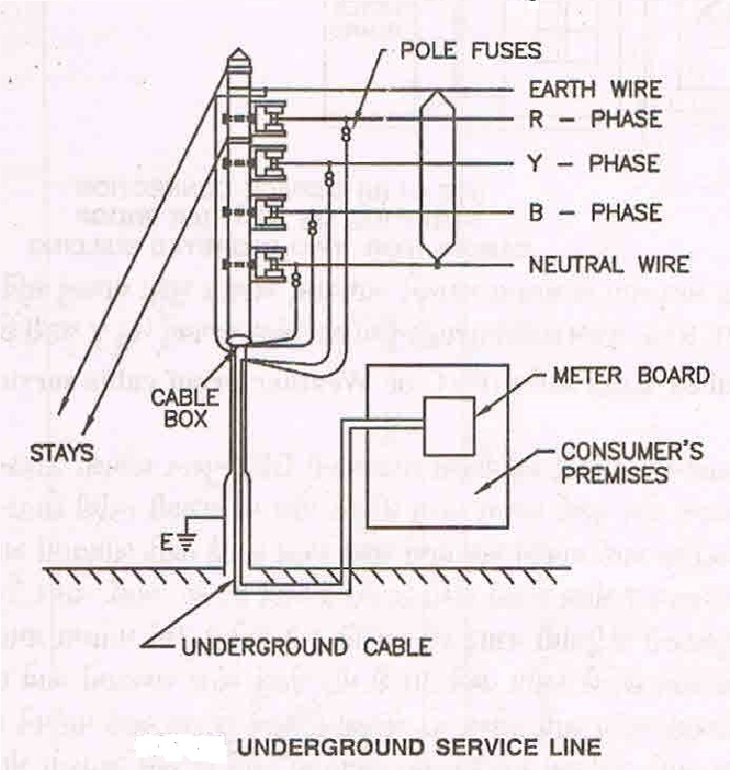
UNDERGROUND SERVICE LINE

Slide 21
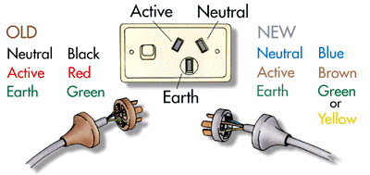
Colour codes for wire

Slide 22
ANY QUESTIONS ???

